Slide 1
Master Thesis
Images for Thesis and presentation

Slide 2

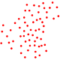
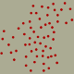
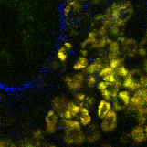
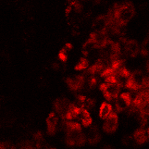
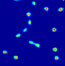
Napari
Point cloud
Labeling with points in 3D
Training data
Density maps for multiple cell classes
U-net
Stack
NADH
Cell Number
Threshold + Object counting

Slide 3


Simulator
Stack
Data
Napari
FIJI
or
Annotation
PointCloud.csv
PointCloud.roi
PointCloud
FAD Synthetic
PointCloud
FAD
Training data
MBT-net
MBT-net

Slide 4
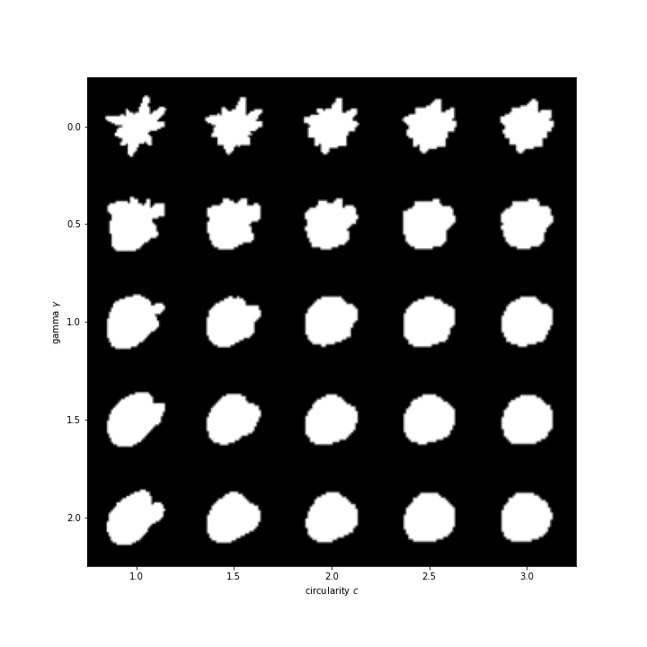
Shape generation with differrent parameters

Slide 5
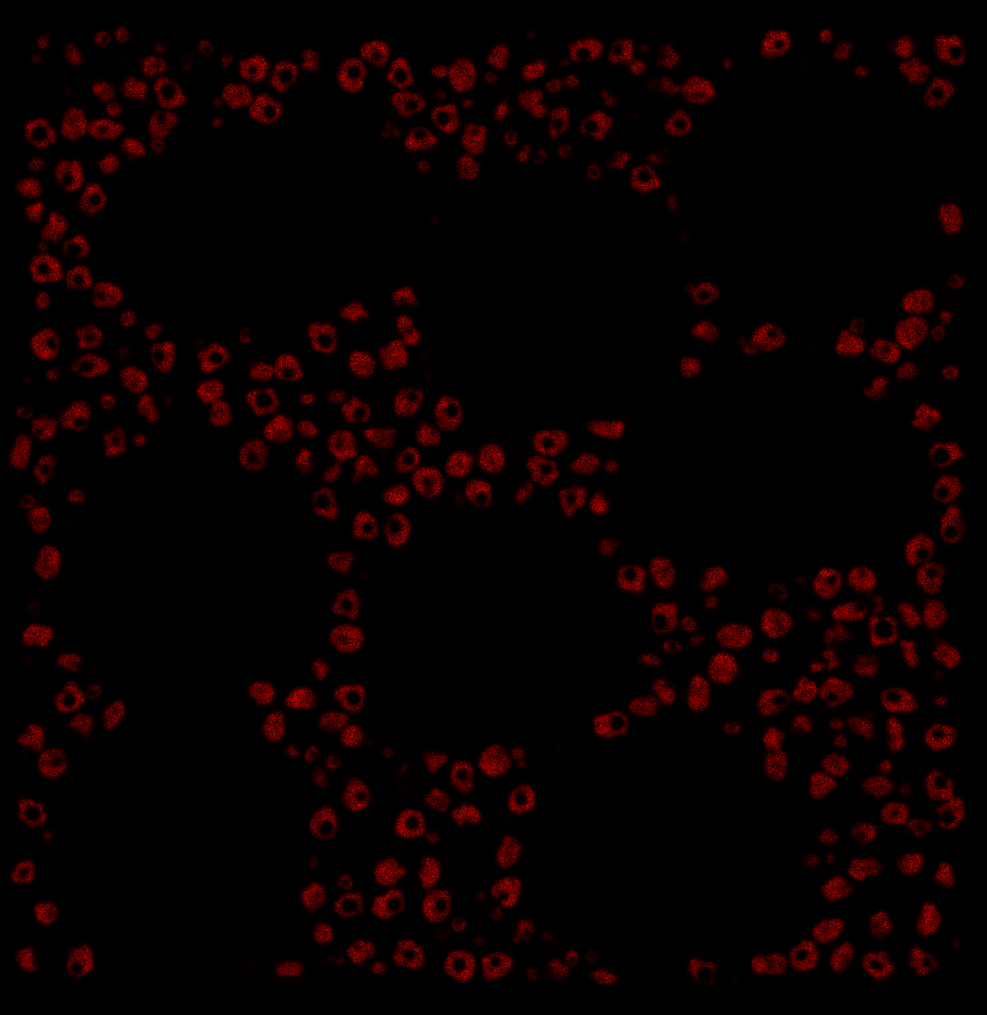
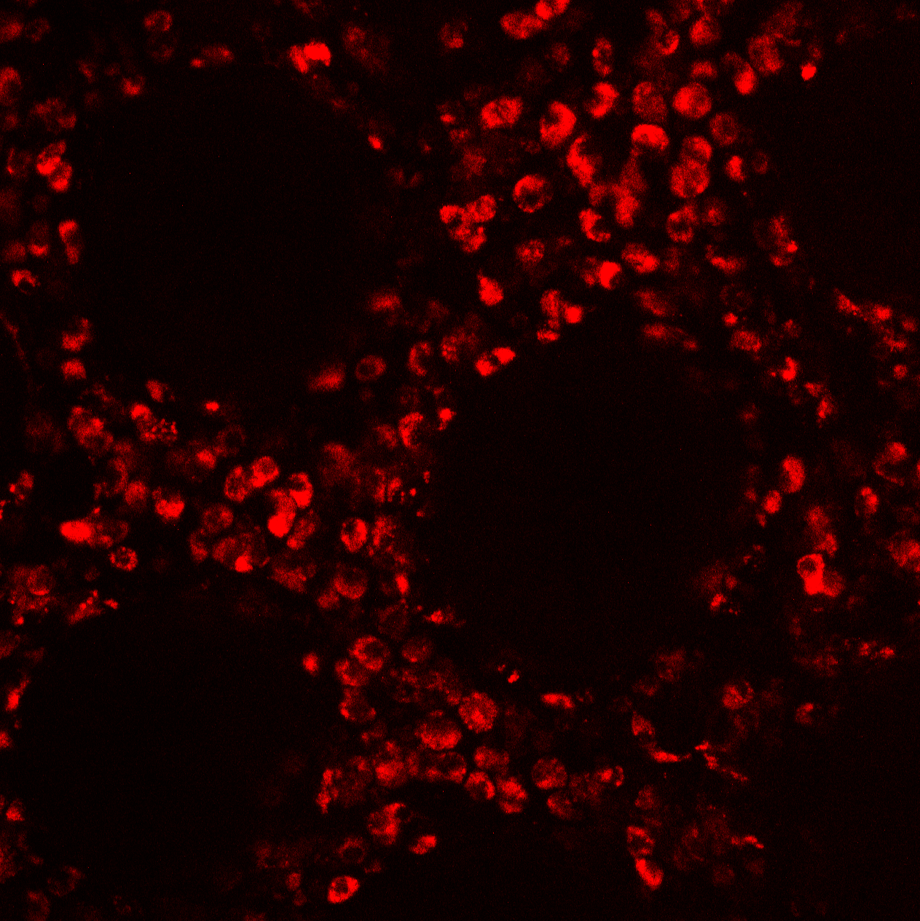
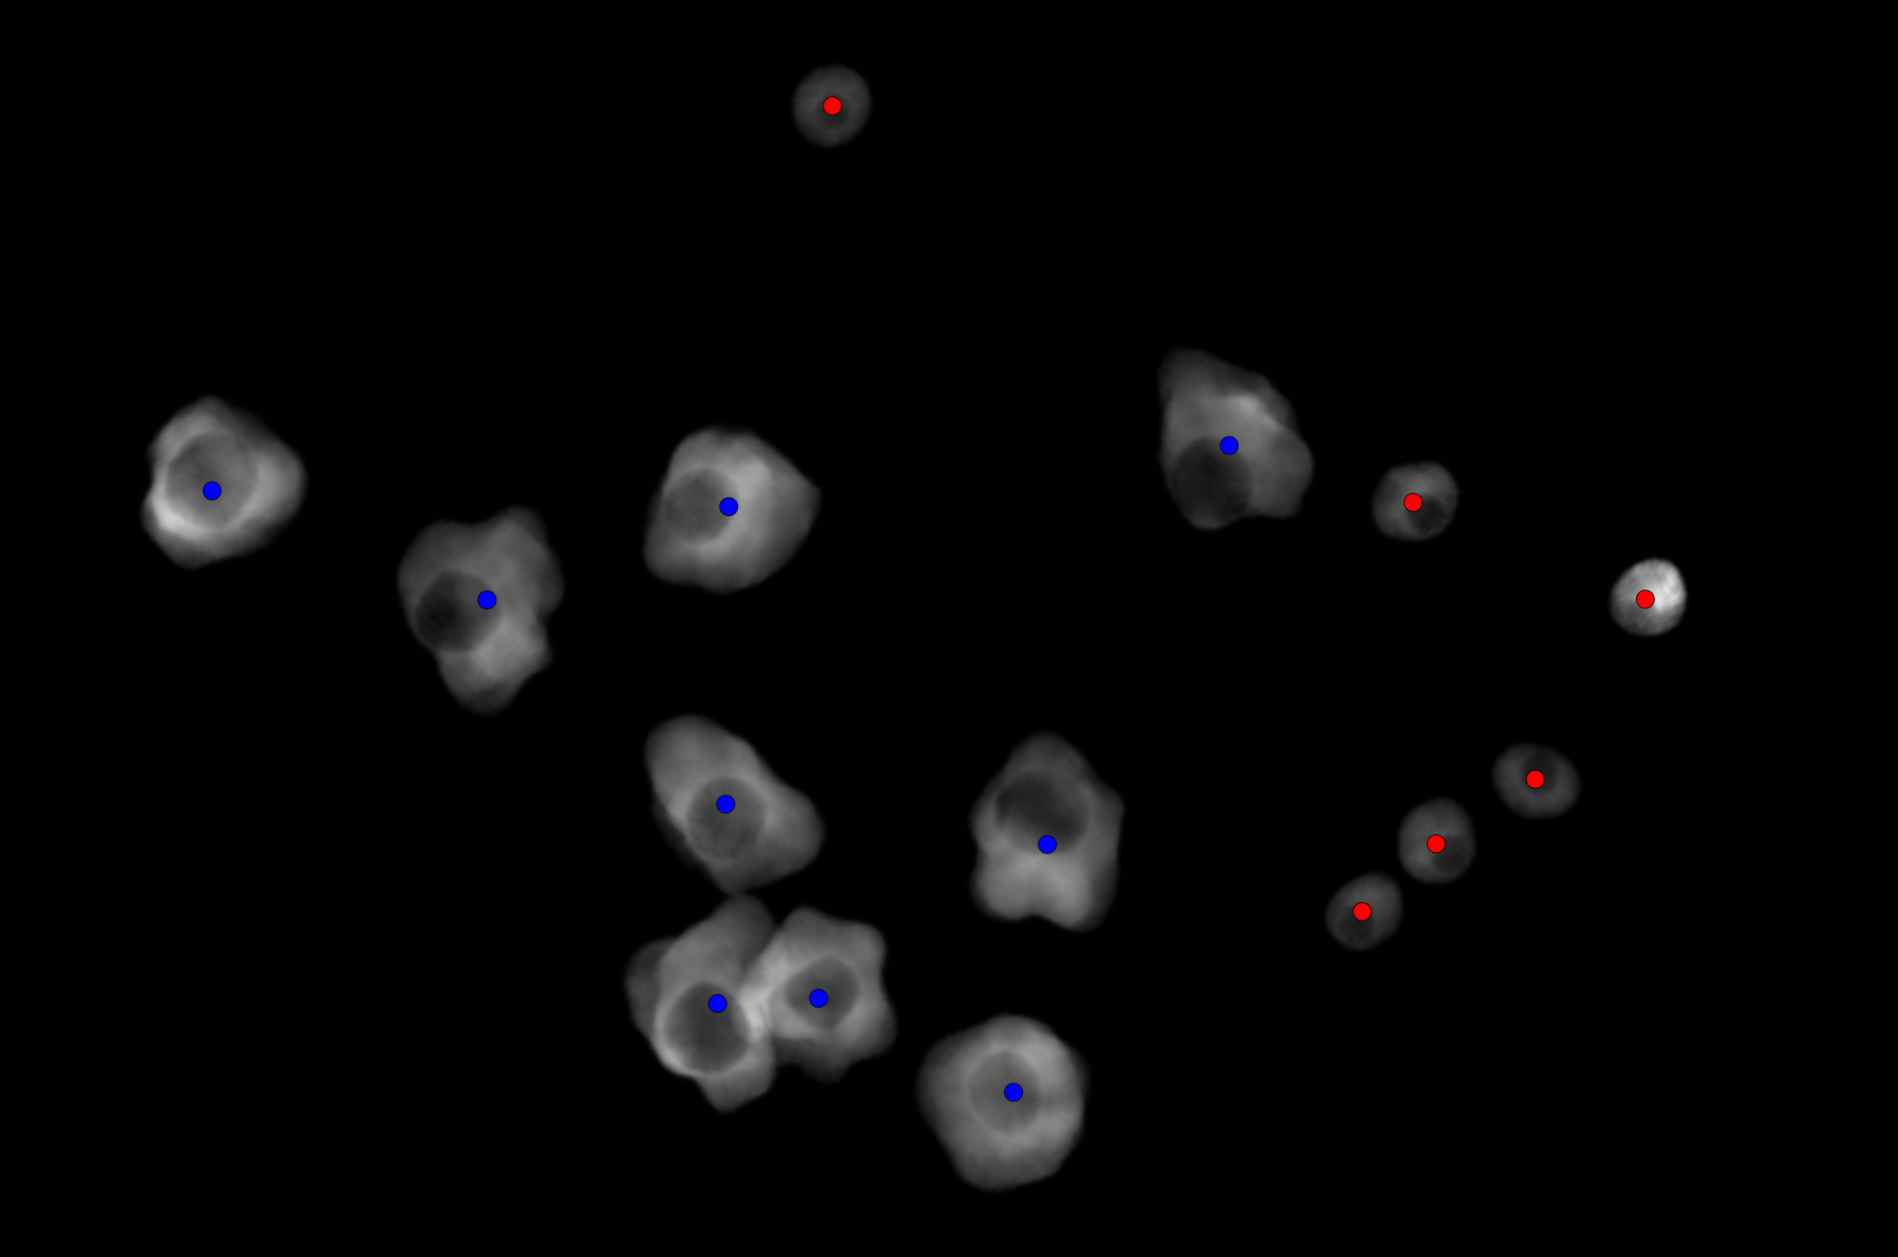
Simulated
Real
Simulated volume view
Macrophage
T-cell
Guess where is the simulated image?

Slide 6
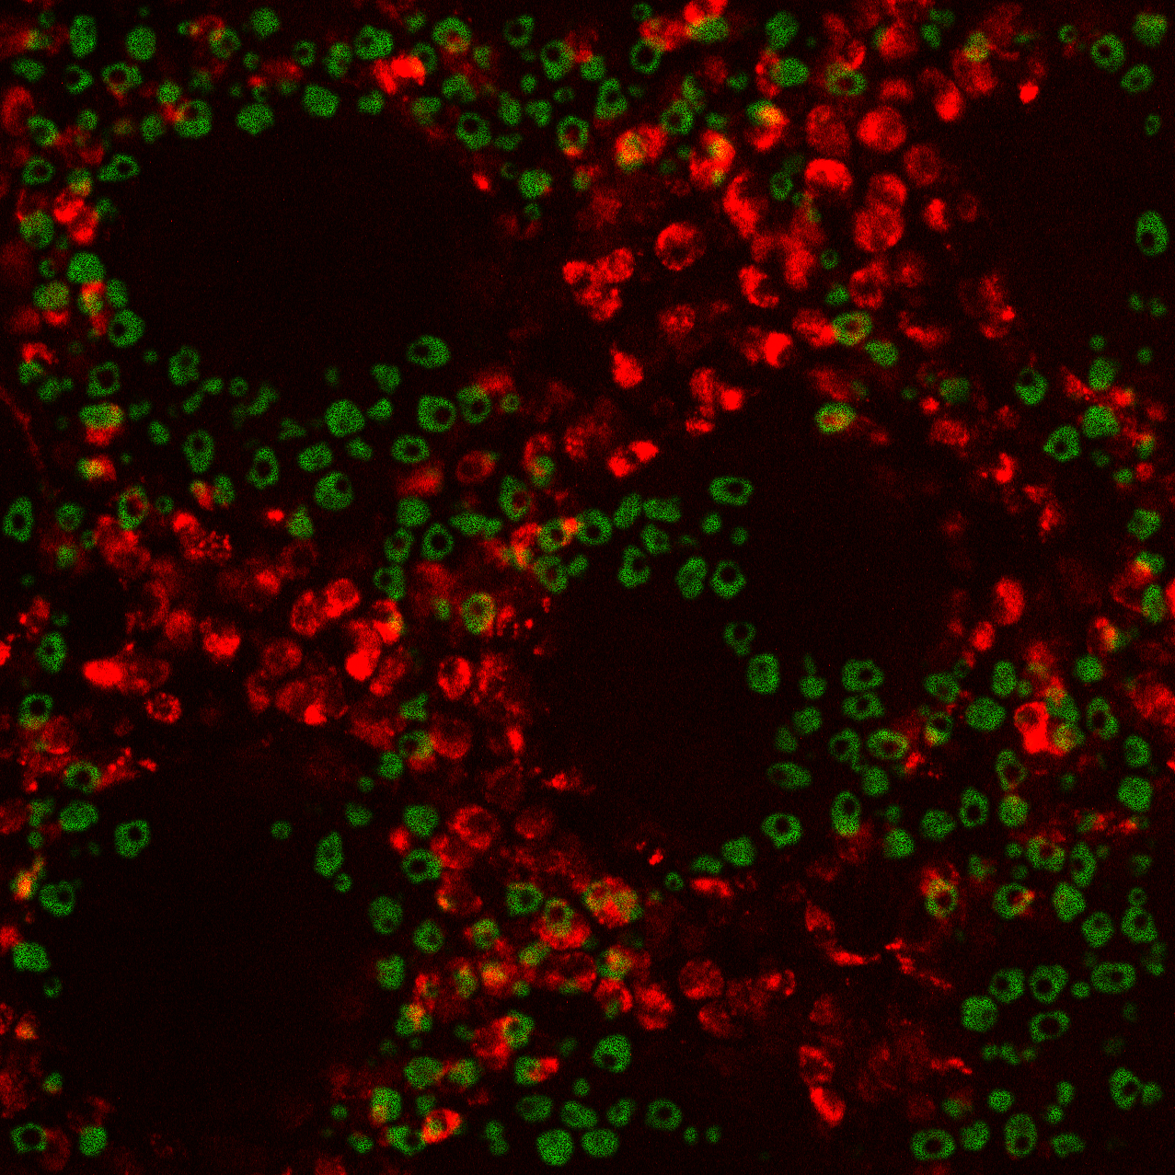

Slide 7
w₁₁
a₁
x₁
w₁₂
a₂
w₁₃
x₂
y₁
w₁₄
a₃
x₃
a₄

Slide 8
a₁
x₁
w₂₁
w₂₂
a₂
x₂
y₁
w₂₃
a₃
w₂₄
x₃
a₄

Slide 9
B.
A.
w₁₁
a₁
a₁
w₂₁
x₁
x₁
w₁₂
w₂₂
a₂
a₂
x₂
w₁₃
y₁
x₂
y₁
w₂₃
a₃
a₃
w₁₄
w₂₄
x₃
x₃
a₄
a₄
C.
A
X
a₁
x₁
a₂
Y
x₂
y₁
a₃
x₃
a₄

Slide 10
a₁
x₁
a₂
x₂
y₁
a₃
x₃
a₄

Slide 11
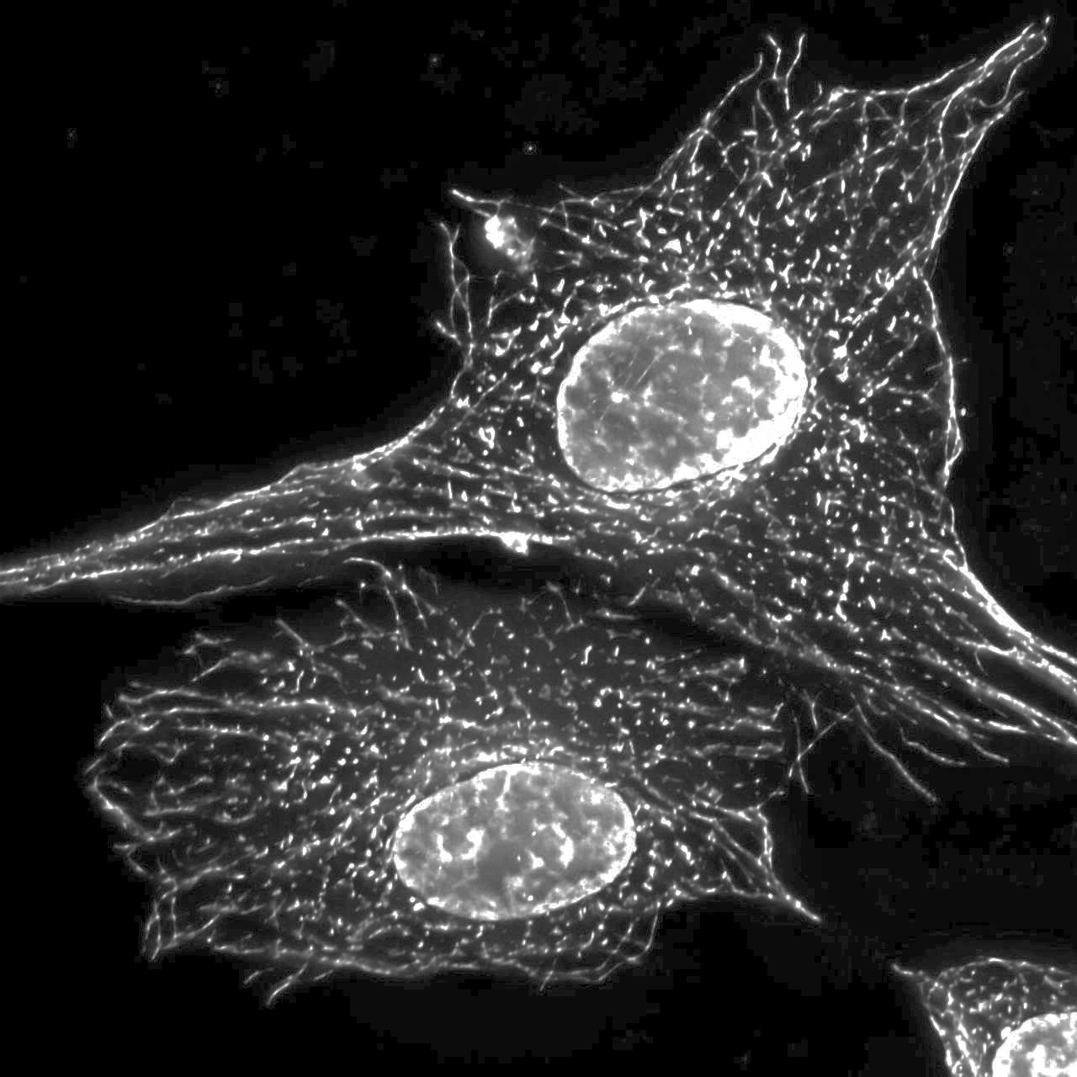
k₁
k₁
k₂
…
k₃
k₂
k₃
k₄

Slide 12
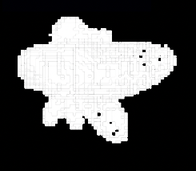
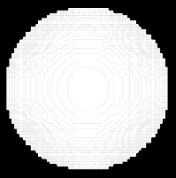
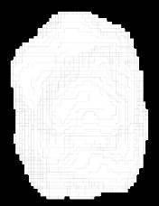
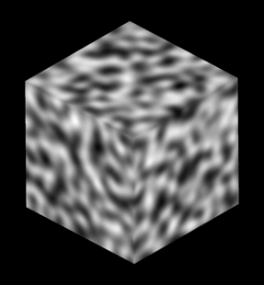
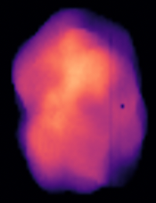
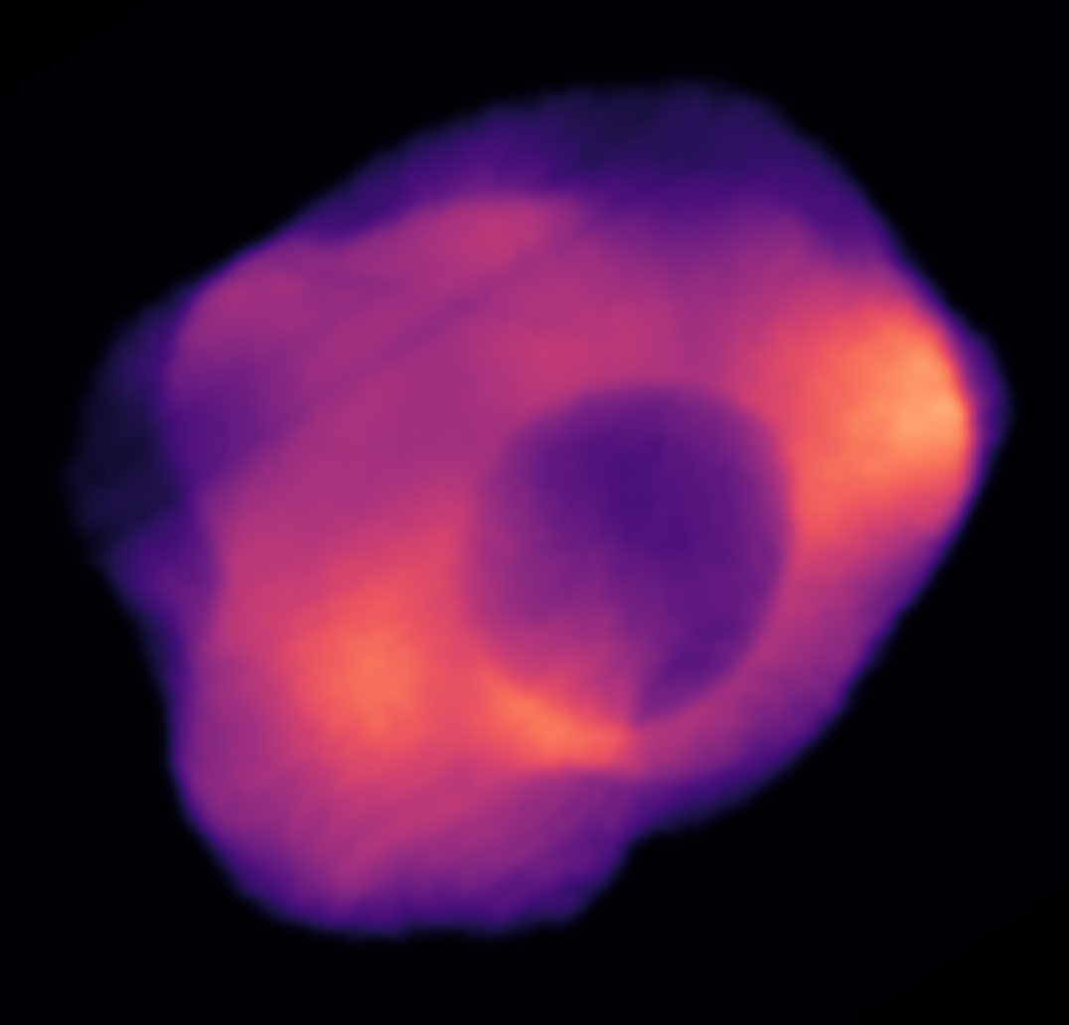
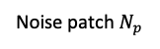
Noise patch $N_{p}$
Resulted blob
shape mask
Noise space
Blob
Sphere
+
=
+
=
Sampling from
noise space
Generate 2 blobs for cell and for nucleus
-
=
Nucleus mask
Noise space
Cell body
Simulated Cell

Slide 13
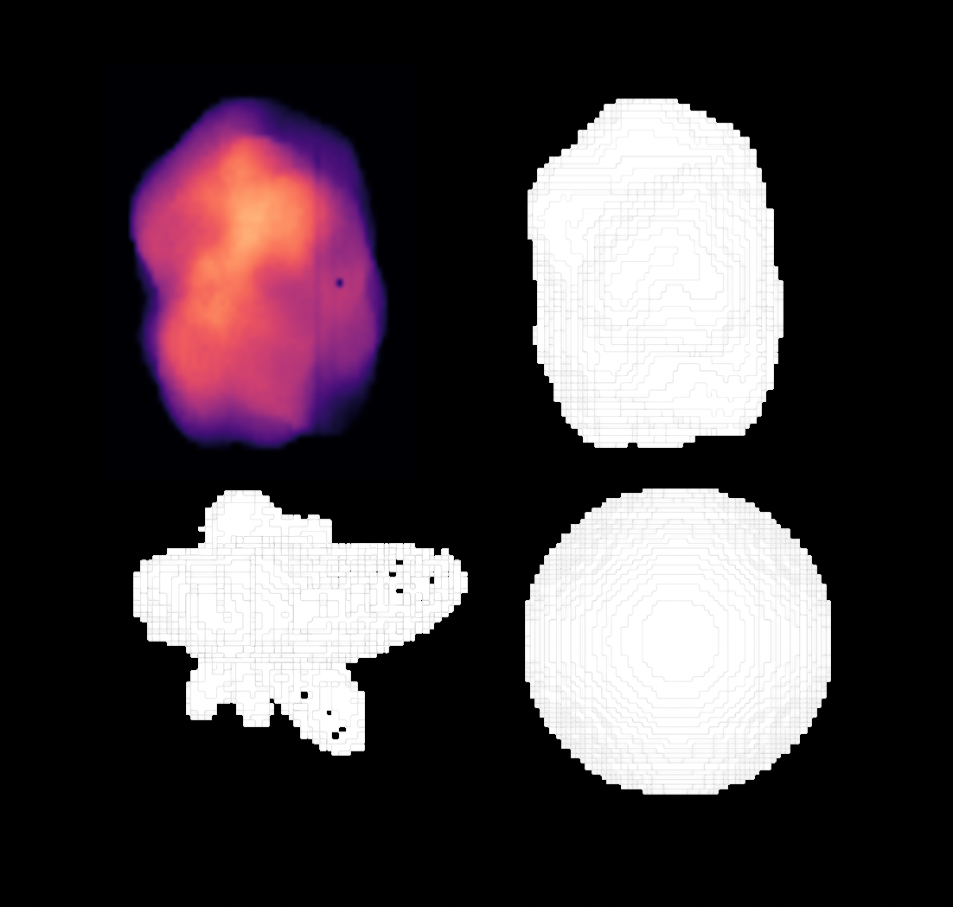

Slide 14
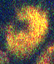
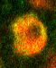
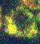
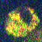
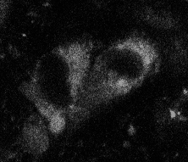
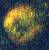
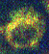
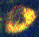
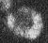
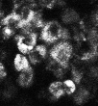
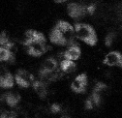

Slide 15

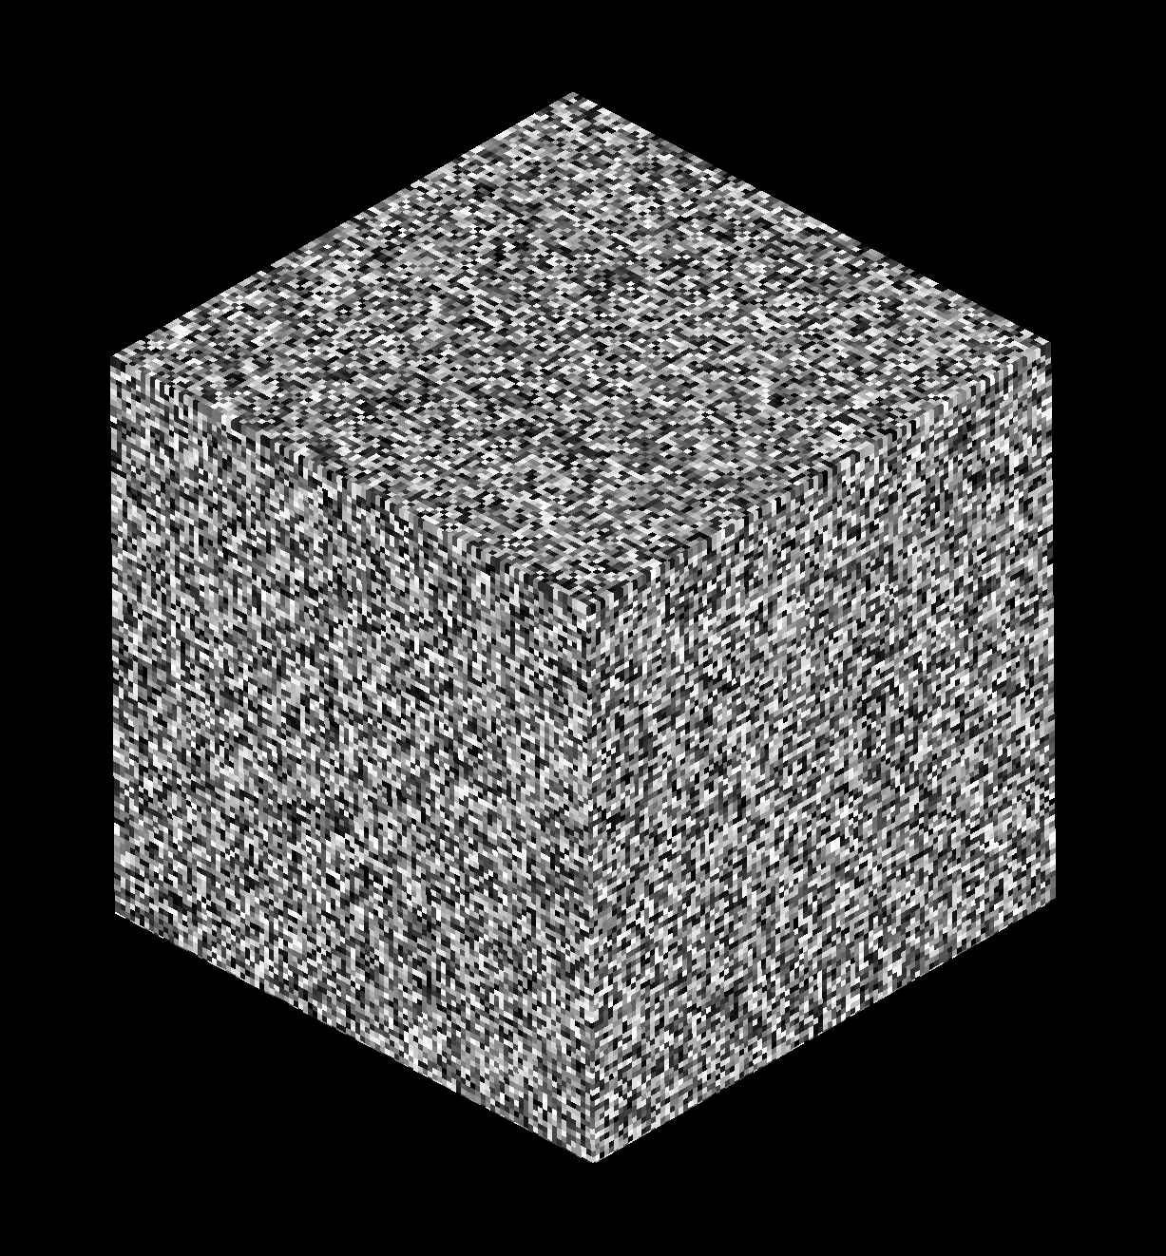
Opensimplex
Random

Slide 16
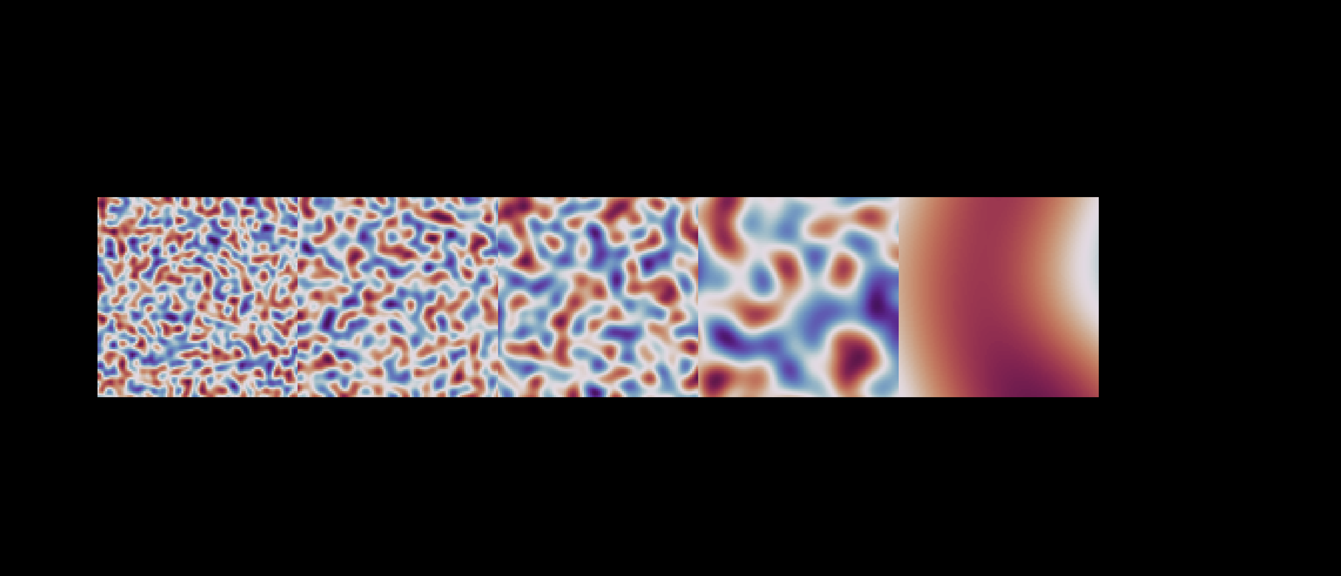

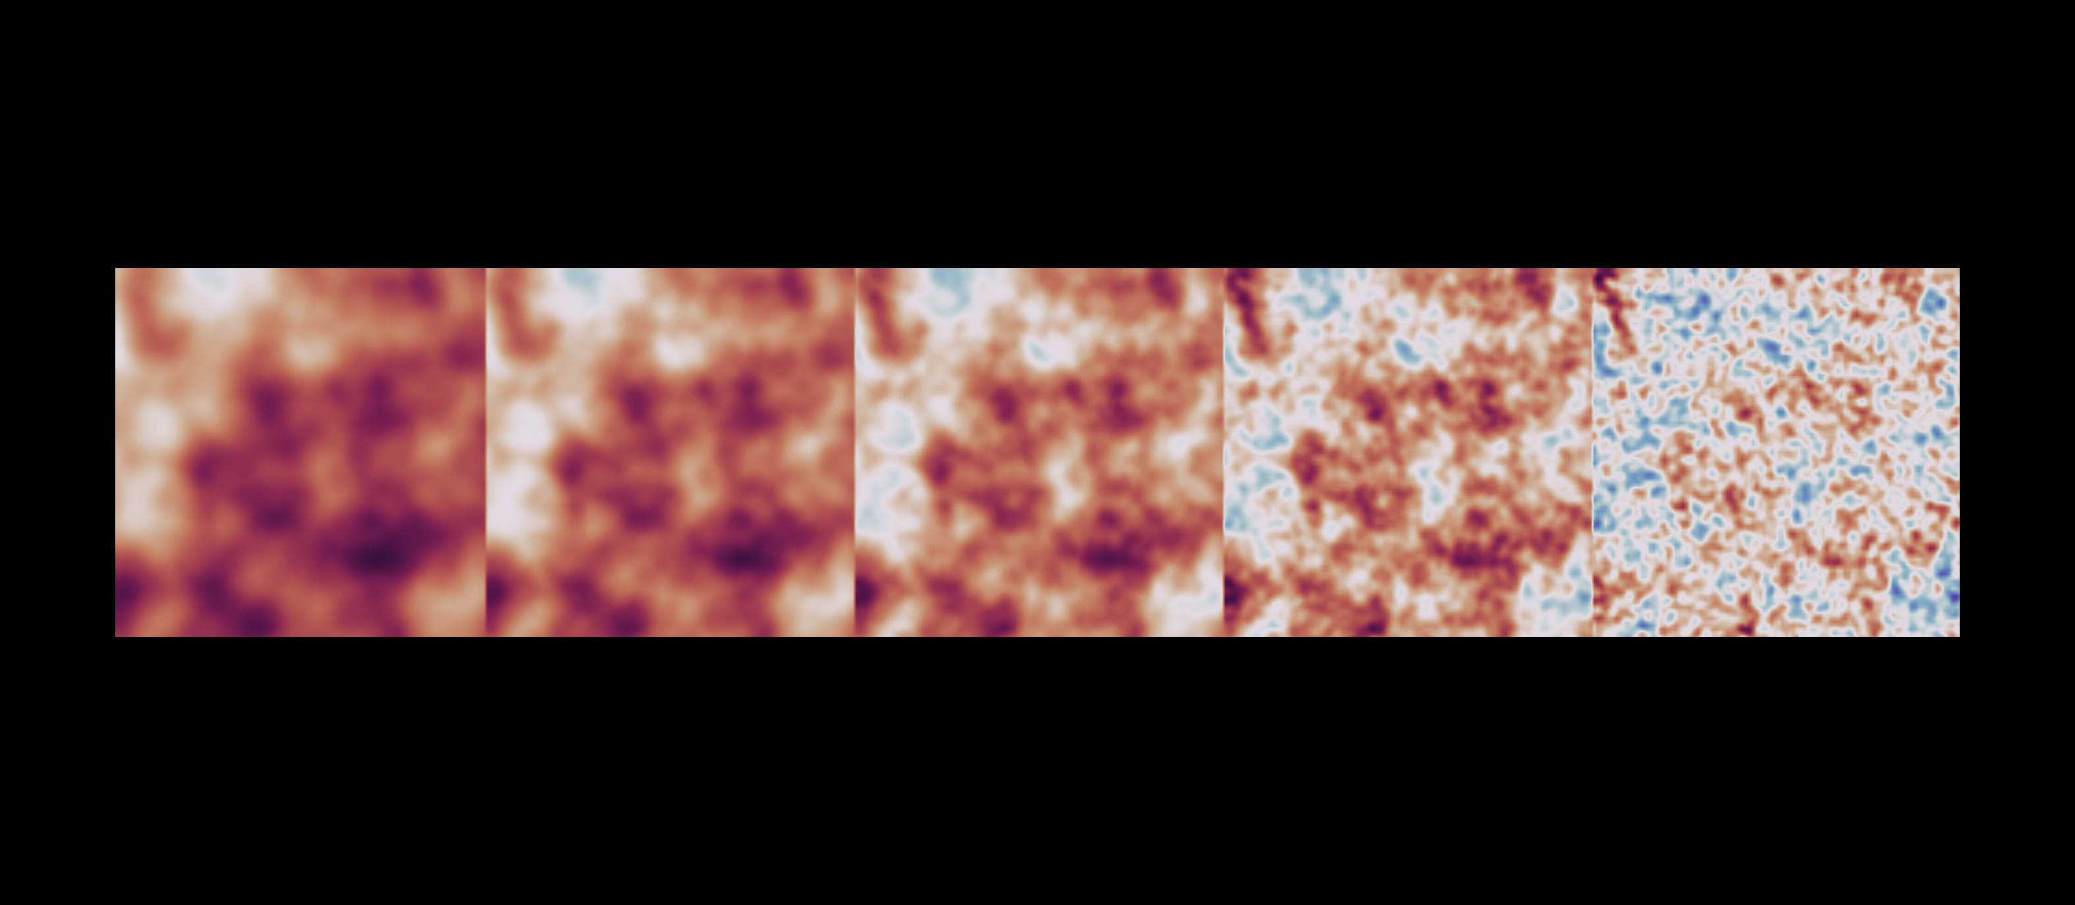
A.
∑
=
⍺
B.
0.0
0.25
0.5
0.75
1.0
𝛾

Slide 17
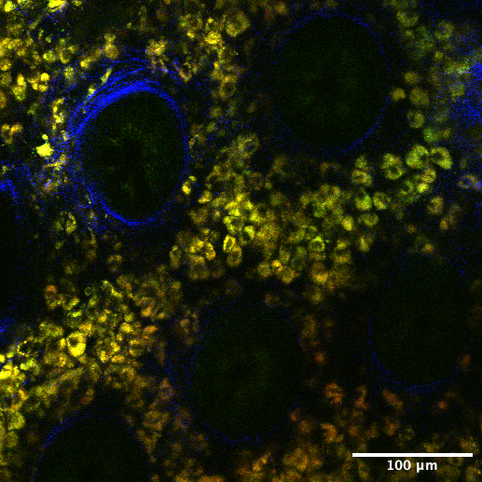
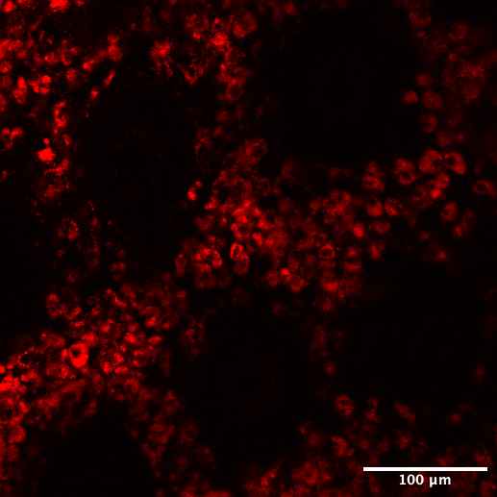
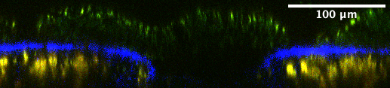
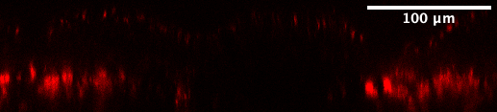
RGB (FAD, NADH, SHG)
R (FAD)
Crypt
Crypt
Crypt
Crypt
Top view
Crypt
Crypt
Crypt
Crypt
Side view
Crypt
Crypt

Slide 18
summation
concatenation
Linknet
U-net

Slide 19
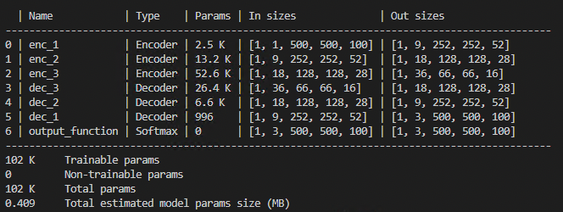
+
+
+
18 x 128 x 128 x 28
36 x 66 x 66 x 16
18 x 128 x 128 x 28
9 x 252 x 252 x 52
MBT-net
9 x 252 x 252 x 52
1 x 500 x 500 x 100
3 x 500 x 500 x 100
Encoder block
Decoder block
BatchNorm
Conv3D
LeakyReLU
Conv3D
LeakyReLU
MaxPool
Interpolation
BatchNorm
Conv3D
LeakyReLU
Conv3D
LeakyReLU

Slide 20
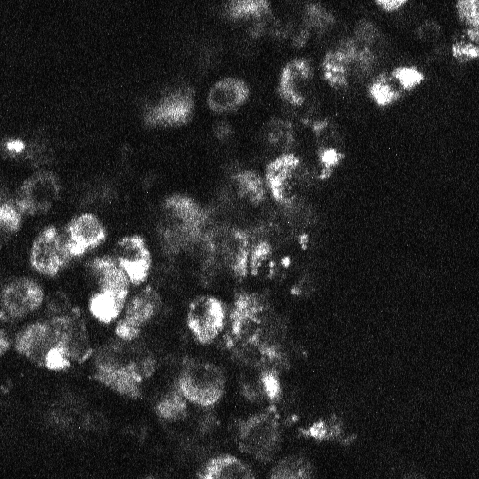

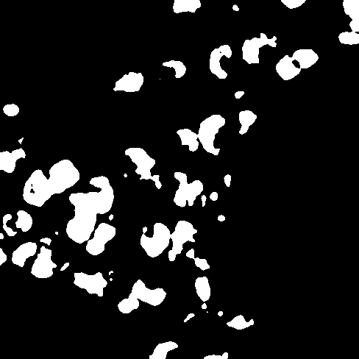


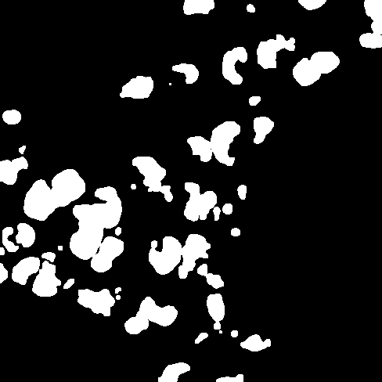

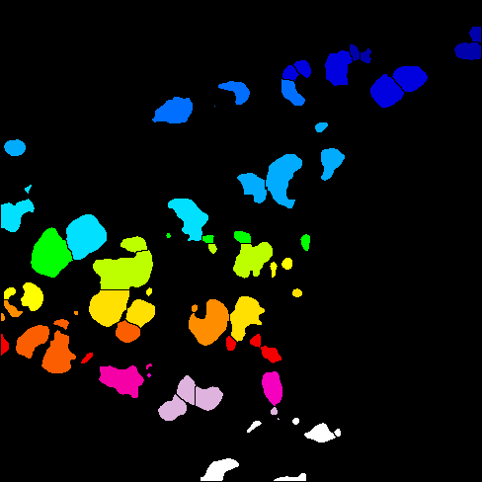
0.Raw
1.Blur
2.Threshold
3.Fill holes
4.Erode
5.Dilate
6.Watershed
7.Label

Slide 21
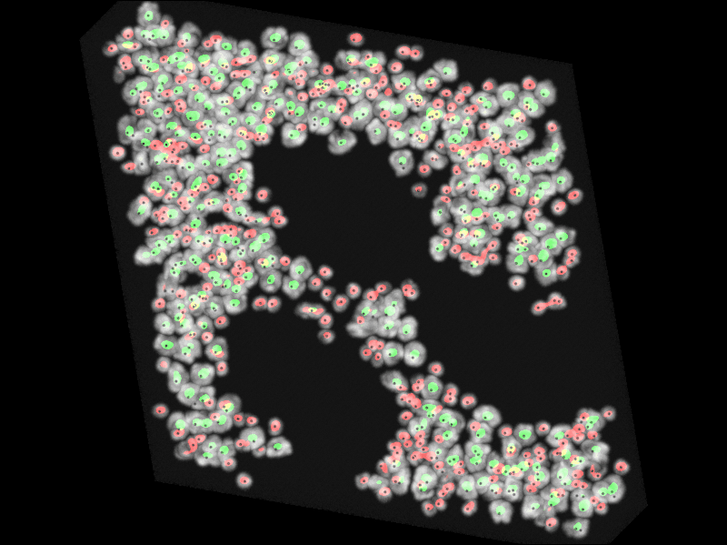
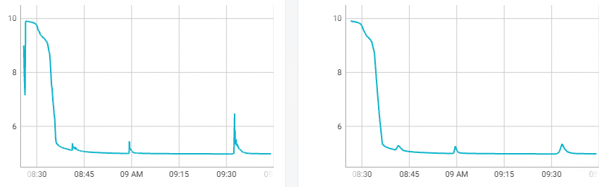
Train loss
Loss, ul
Training time
Validation loss
Loss, ul
Training time

Slide 22
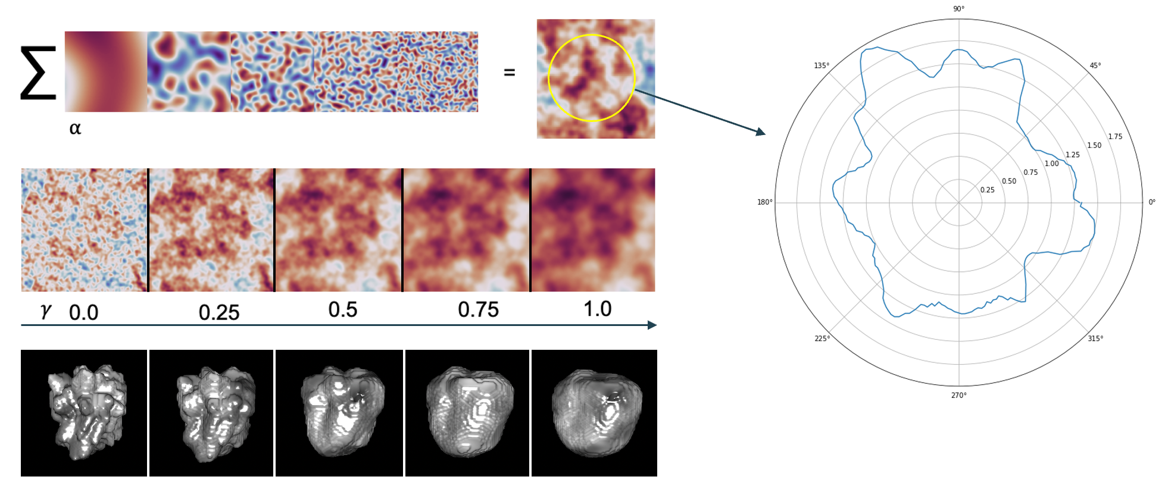
A.
C.
B.

Slide 23
Train loss
Validation loss
Loss, ul
Loss, ul
Training time
Training time

